Slide 1
Sing Image Processing by Generative Models
Wen Liu
2019/12/1
[1] Dmitry Ulyanov, Andrea Vedaldi, and Victor Lempitsky. Deep Image Prior. CVPR 2018, 9446-9454.
[2] Tamar Rott Shaham, Tali Dekel, and Tomer Michaeli. SinGAN: Learning a Generative Model from a Single Natural Image. ICCV 2019.

Slide 2
Tasks
Image Inpainting
Super Resolution
Image Denoising

Slide 3
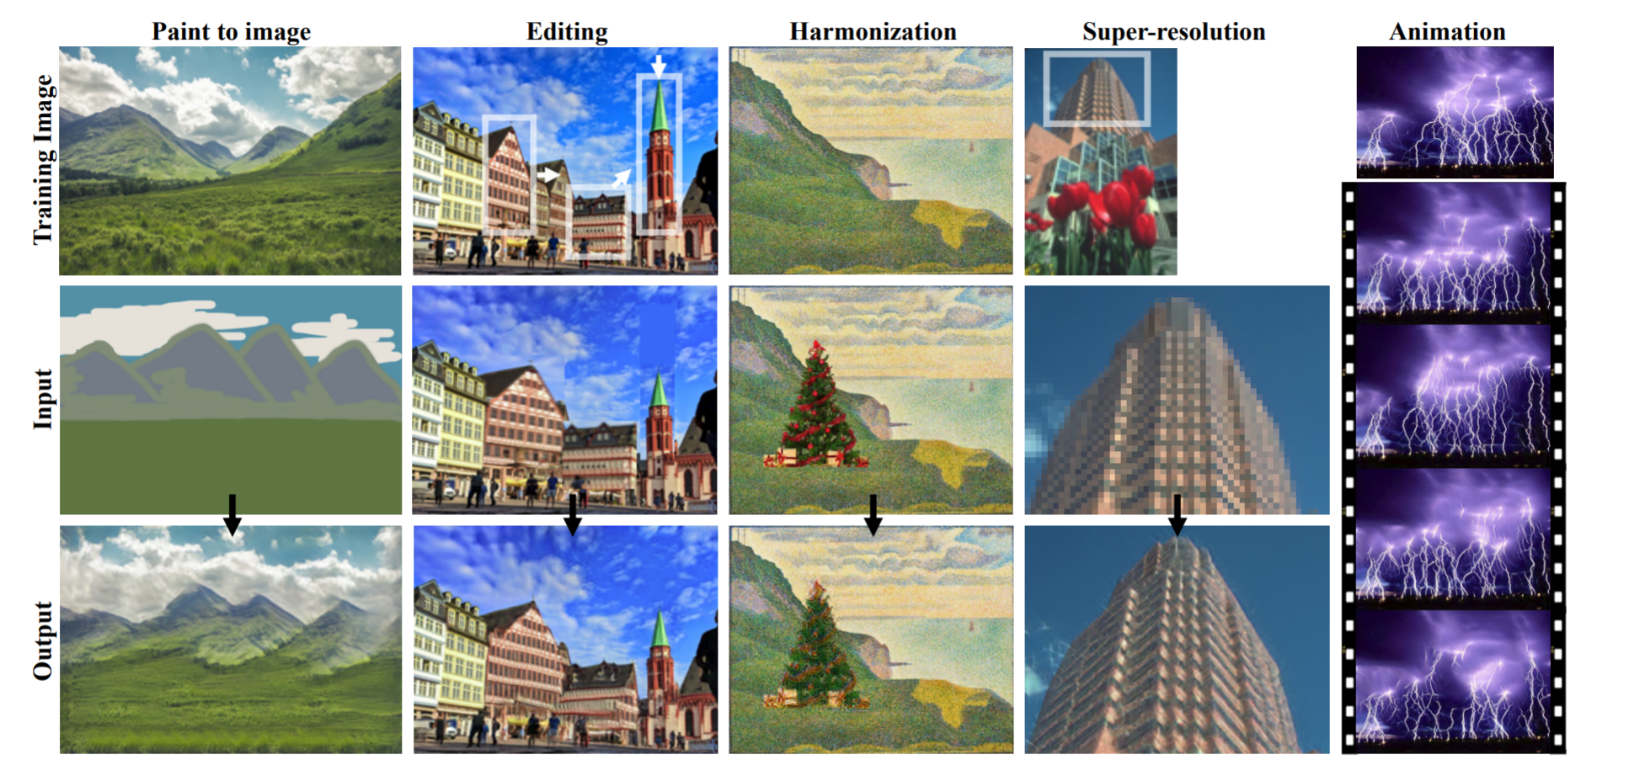
Cont’d
Paint-to-Image
Harmonization
Editing
Single Image Animation
Tamar Rott Shaham, Tali Dekel, and Tomer Michaeli. SinGAN: Learning a Generative Model from a Single Natural Image. ICCV 2019.

Slide 4
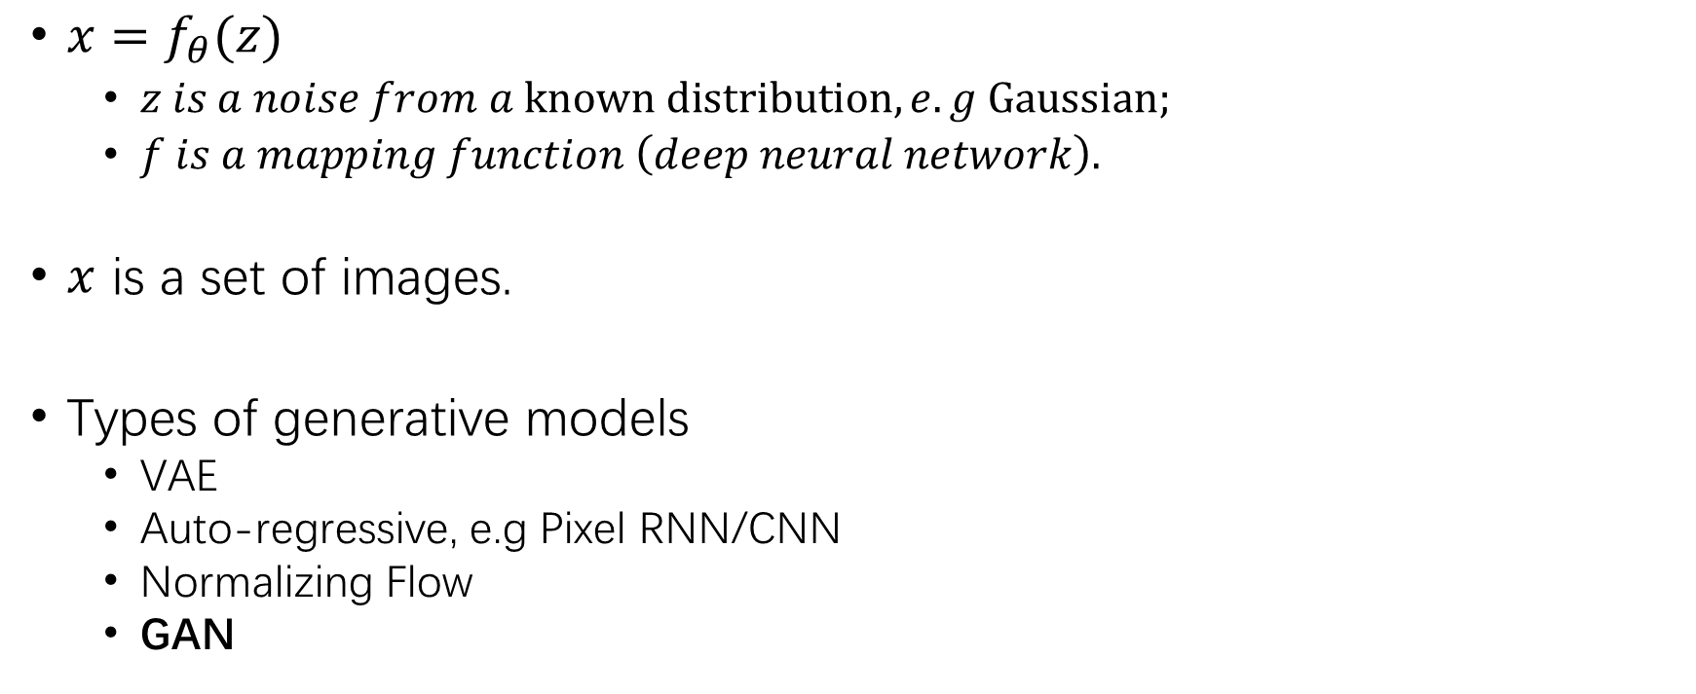
Deep Generative Models
$x=f_{θ}(z)$
$z is a noise from a known distribution, e.g Gaussian;$
$f is a mapping function \left(deep neural network\right).$
$x$ is a set of images.
Types of generative models
VAE
Auto-regressive, e.g Pixel RNN/CNN
Normalizing Flow
GAN

Slide 5
When x is a single image?
Deep Image Prior
SinGAN
[1] Dmitry Ulyanov, Andrea Vedaldi, and Victor Lempitsky. Deep Image Prior. CVPR 2018, 9446-9454.
[2] Tamar Rott Shaham, Tali Dekel, and Tomer Michaeli. SinGAN: Learning a Generative Model from a Single Natural Image. ICCV 2019.

Slide 6
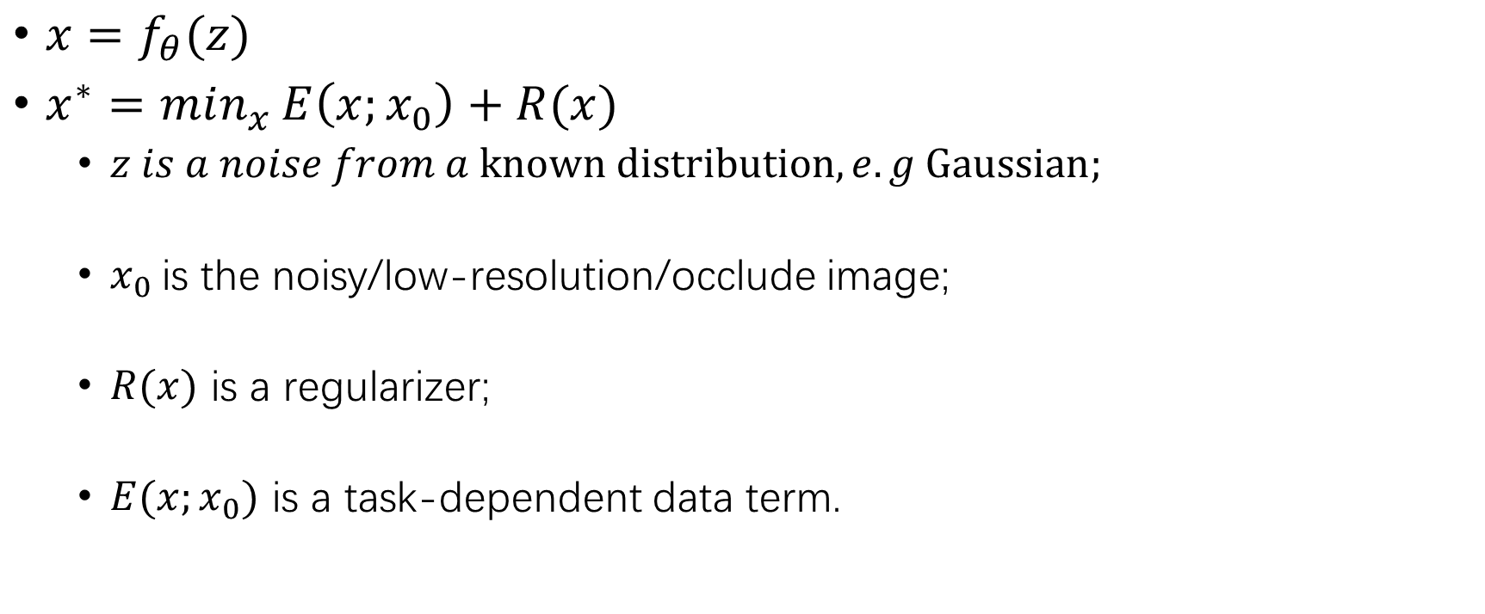
Deep Image Prior
$x=f_{θ}(z)$
$x^{∗}=min_{x}{E\left(x;x_{0}\right)+R(x)}$
$z is a noise from a known distribution, e.g Gaussian;$
$x_{0}$is the noisy/low-resolution/occlude image;
$R(x)$ is a regularizer;
$E(x;x_{0})$ is a task-dependent data term.
[1] Dmitry Ulyanov, Andrea Vedaldi, and Victor Lempitsky. Deep Image Prior. CVPR 2018, 9446-9454.
Notes:
1. 用随机参数初始化深度卷积网络f。
2. 令f的输入为固定的随机编码z。
3. 令f的目标为：输入z，输出x。以此训练f的参数。
4. 注意选择合适的损失函数。例如对于降噪问题可关注整体的MSE，对于填充问题就应该只关心不需要填充的位置的MSE。当训练很久之后，f可实现输出一模一样的x。
6. 但如果在训练到一半时打断f，会发现它会输出一幅“修复过的x”

Slide 7
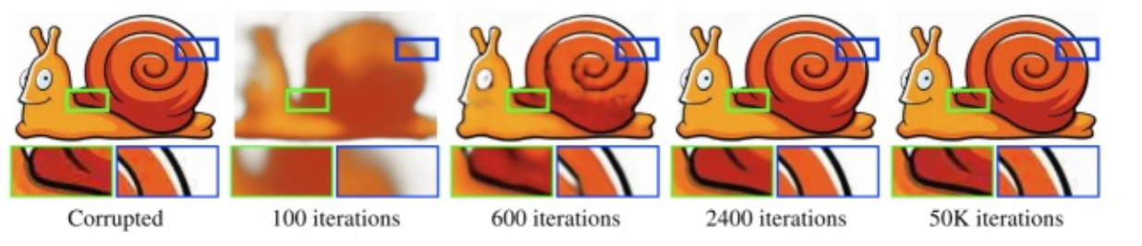
Deep Image Prior
[1] Dmitry Ulyanov, Andrea Vedaldi, and Victor Lempitsky. Deep Image Prior. CVPR 2018, 9446-9454.
Notes:
请看图片例子。最左边是目标图像，它经过JPEG压缩，有很多压缩瑕疵。网络的目标是学会输出它。
在100次迭代后，网络学会了输出很模糊的形体。
在2400次迭代后，网络学会了输出一张清晰光滑的高质量图片。
在50000次迭代后，网络才学会了输出原图。

Slide 8
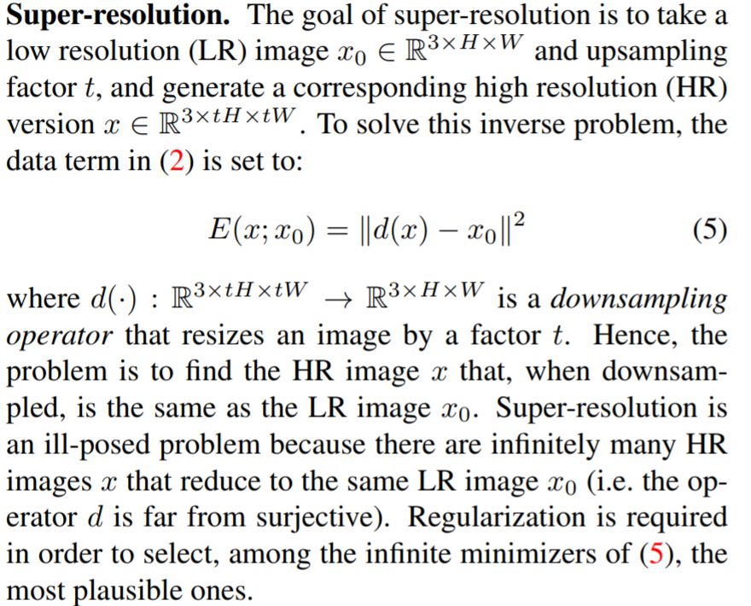
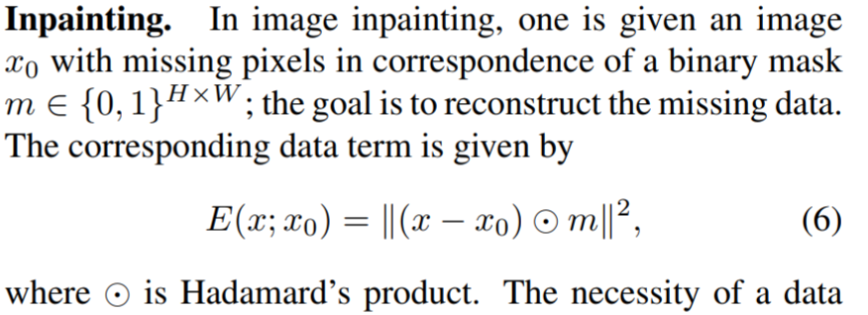
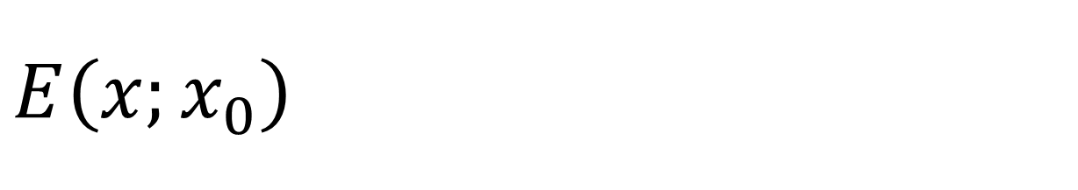
$E\left(x;x_{0}\right)$
[1] Dmitry Ulyanov, Andrea Vedaldi, and Victor Lempitsky. Deep Image Prior. CVPR 2018, 9446-9454.

Slide 9
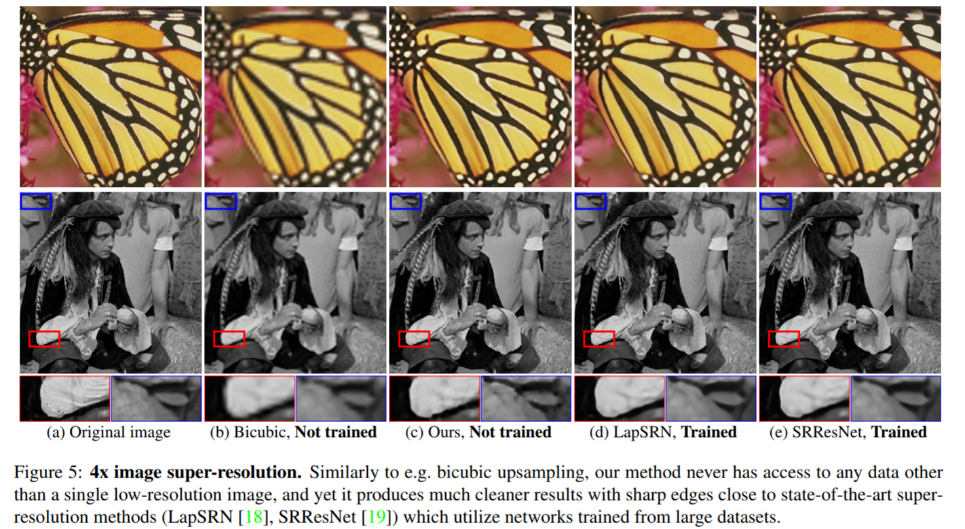
Results
[1] Dmitry Ulyanov, Andrea Vedaldi, and Victor Lempitsky. Deep Image Prior. CVPR 2018, 9446-9454.

Slide 10
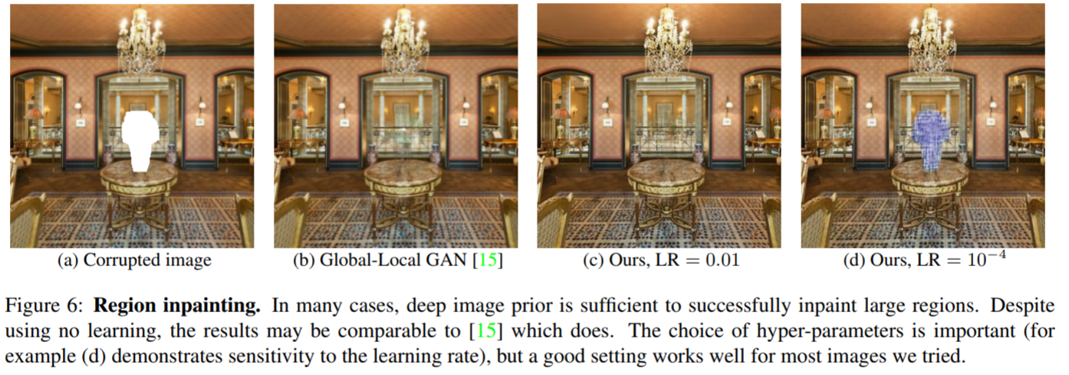
Results
[1] Dmitry Ulyanov, Andrea Vedaldi, and Victor Lempitsky. Deep Image Prior. CVPR 2018, 9446-9454.

Slide 11
Summarization
Only a single image to train the network;
Why work?
Invariant translation by convolution operation?
CNNs are good at handle repeat textures?
Shortcomings?
Each image need to train a neural network from scratch, and Is it possible to use a pre-trained model to fine-tune the model and speed up?
How to get a decent result under fixed training iterations for all images?
[1] Dmitry Ulyanov, Andrea Vedaldi, and Victor Lempitsky. Deep Image Prior. CVPR 2018, 9446-9454.

Slide 12
SinGAN
Multi-scale/patch generator and discriminator
Additional Reconstruction Loss: training stable
[2] Tamar Rott Shaham, Tali Dekel, and Tomer Michaeli. SinGAN: Learning a Generative Model from a Single Natural Image. ICCV 2019.
Notes:
1. 用随机参数初始化深度卷积网络f。
2. 令f的输入为固定的随机编码z。
3. 令f的目标为：输入z，输出x。以此训练f的参数。
4. 注意选择合适的损失函数。例如对于降噪问题可关注整体的MSE，对于填充问题就应该只关心不需要填充的位置的MSE。当训练很久之后，f可实现输出一模一样的x。
6. 但如果在训练到一半时打断f，会发现它会输出一幅“修复过的x”

Slide 13
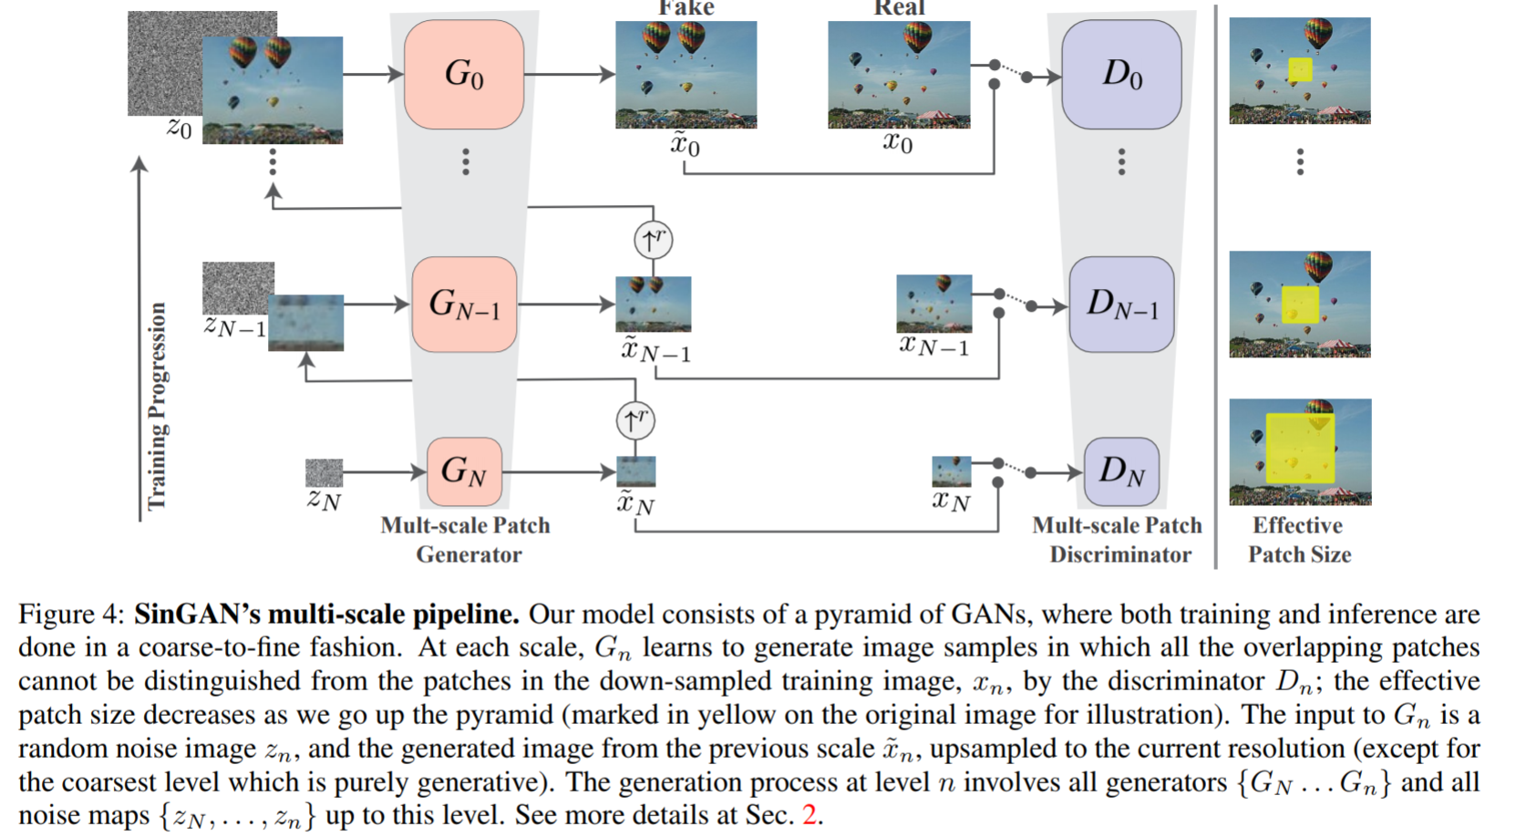
Pipeline
[2] Tamar Rott Shaham, Tali Dekel, and Tomer Michaeli. SinGAN: Learning a Generative Model from a Single Natural Image. ICCV 2019.

Slide 14
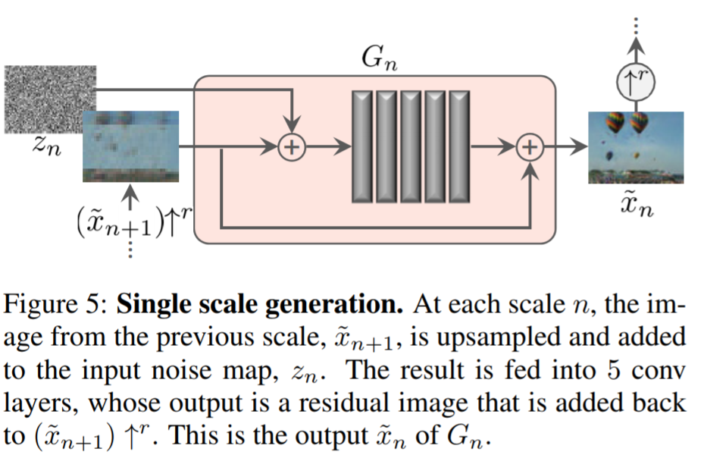
Pipeline
[2] Tamar Rott Shaham, Tali Dekel, and Tomer Michaeli. SinGAN: Learning a Generative Model from a Single Natural Image. ICCV 2019.

Slide 15
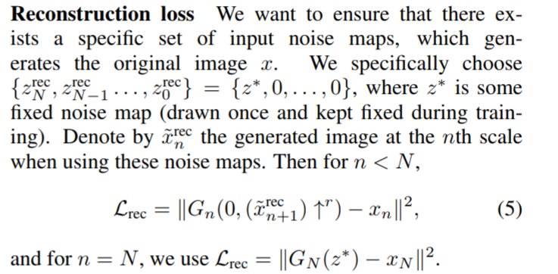
Training Loss
Multi-scale Adversarial loss:
WGAN-GP
Patch Discriminator
Reconstruction Loss over the smallest scale image:
[2] Tamar Rott Shaham, Tali Dekel, and Tomer Michaeli. SinGAN: Learning a Generative Model from a Single Natural Image. ICCV 2019.

Slide 16
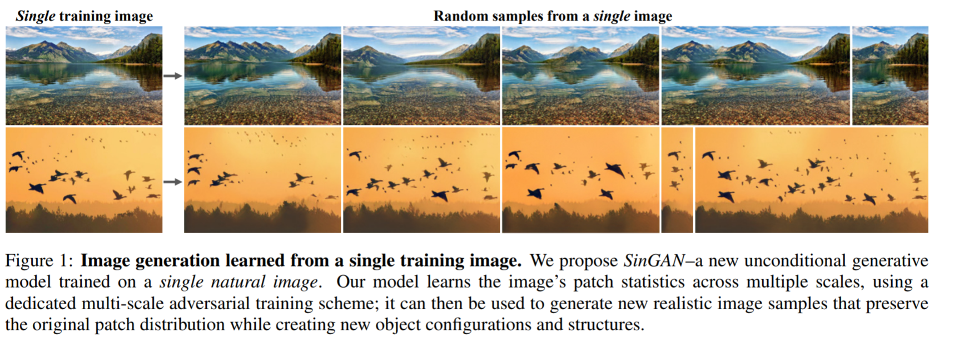
Results
[2] Tamar Rott Shaham, Tali Dekel, and Tomer Michaeli. SinGAN: Learning a Generative Model from a Single Natural Image. ICCV 2019.

Slide 17
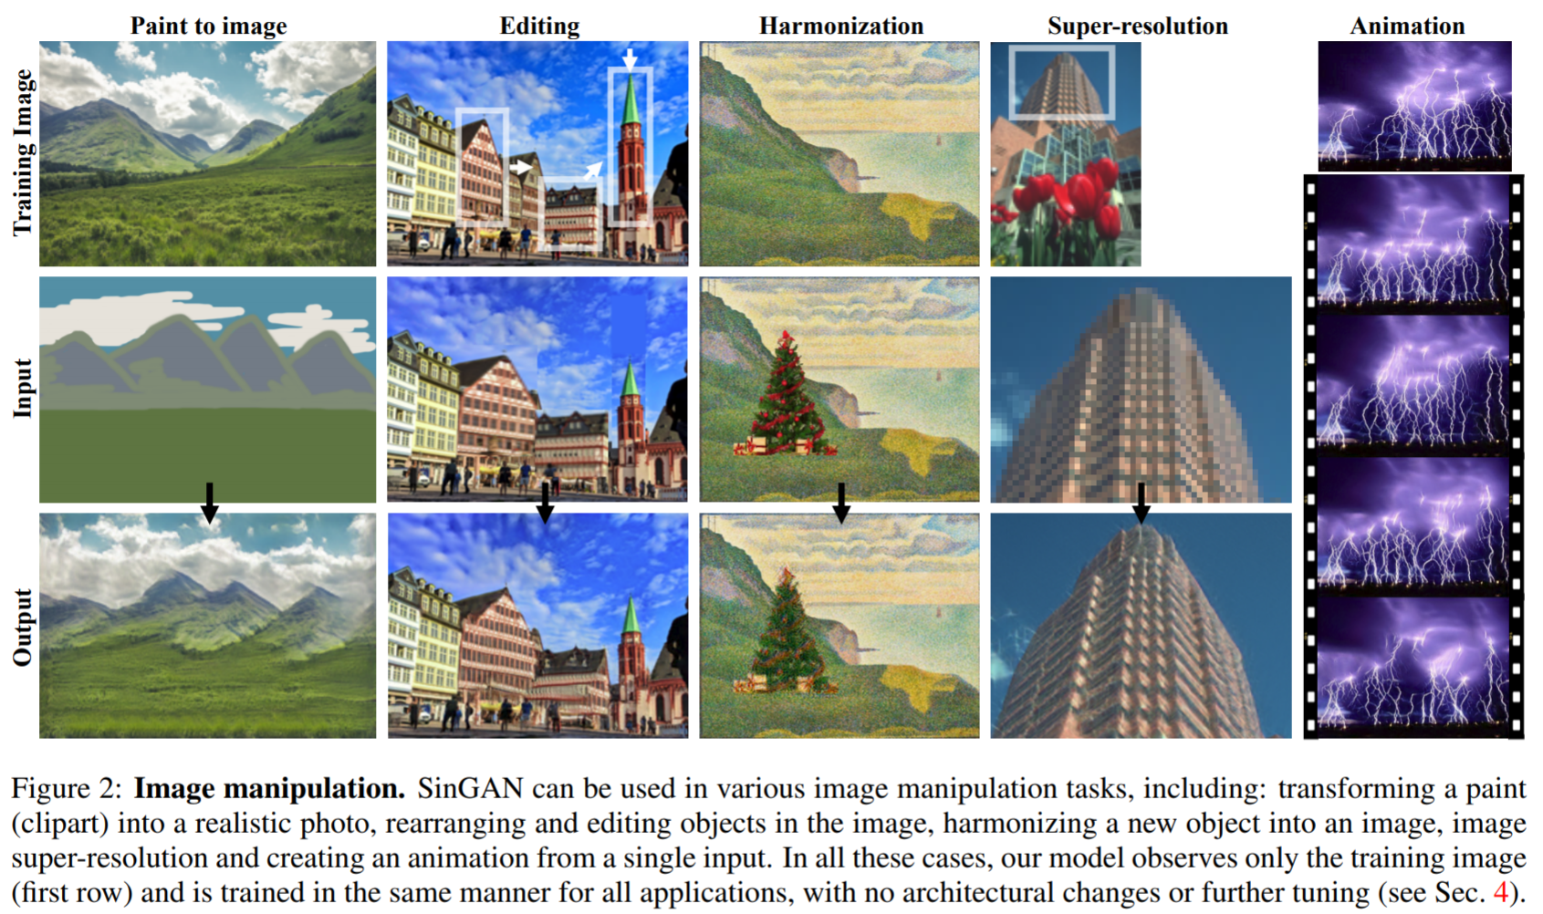
Results
[2] Tamar Rott Shaham, Tali Dekel, and Tomer Michaeli. SinGAN: Learning a Generative Model from a Single Natural Image. ICCV 2019.

